Slide 1
Wireframe-Based Pothole Detection and Avoidance System
Project Sequence 1
BATCH - 02 Presented by MOHAMED B SIRAJUDDEEN (22TD0053)

Slide 2
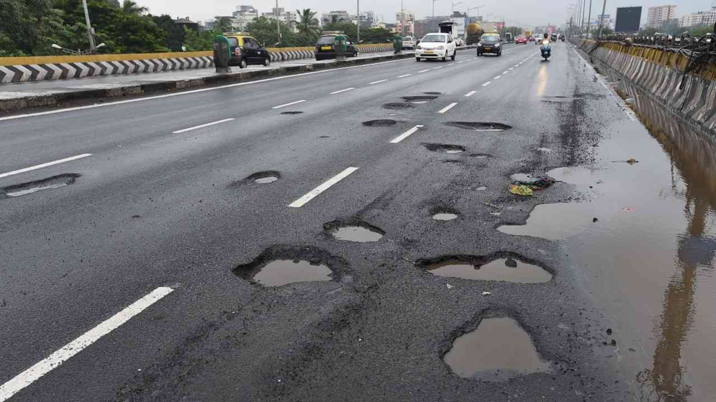
Problem Statement
Abstract
Autonomous vehicles rely heavily on object detection and navigation systems that are typically optimized for structured and well-maintained roads. However, in countries like India, where road infrastructure is often inconsistent with frequent potholes, speed bumps, and surface deformities standard AV systems struggle to operate reliably. These surface anomalies not only reduce ride quality but also pose serious safety risks. Conventional solutions using LiDAR and high-end sensors are expensive and impractical for mass deployment. There is a need for a cost-effective, camera-based solution capable of detecting, analyzing, and responding to road surface anomalies in real-time.

Slide 3
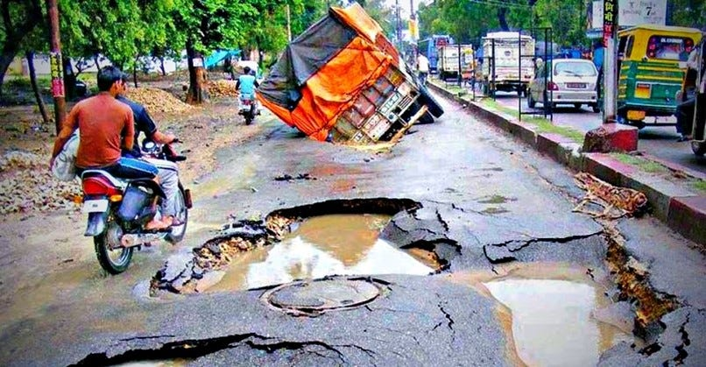
Something you can expect only to happen in India

Slide 4
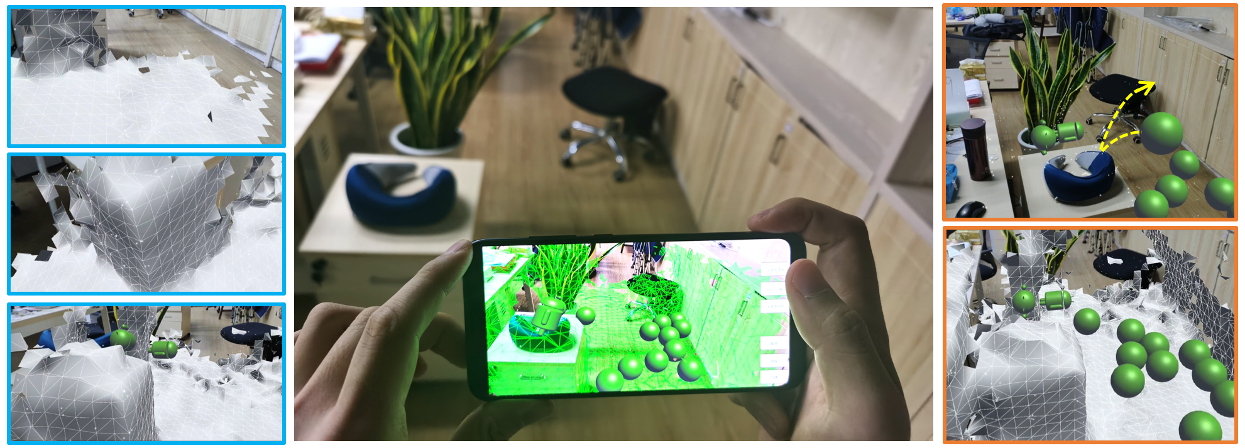
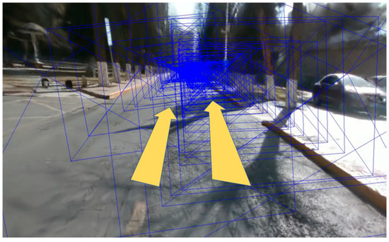
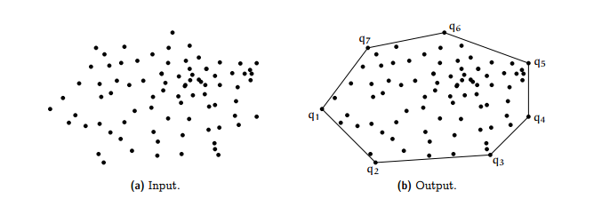
Existing Work in Pothole Detection
YOLO-based detection (YOLOv5, YOLOv8)
LiDAR + Camera fusion for accurate depth
Point cloud and Convex Hull for geometry
Mobile3DRecon – real-time monocular mesh
RoGs – road-specific Gaussian surfel reconstruction

Slide 5
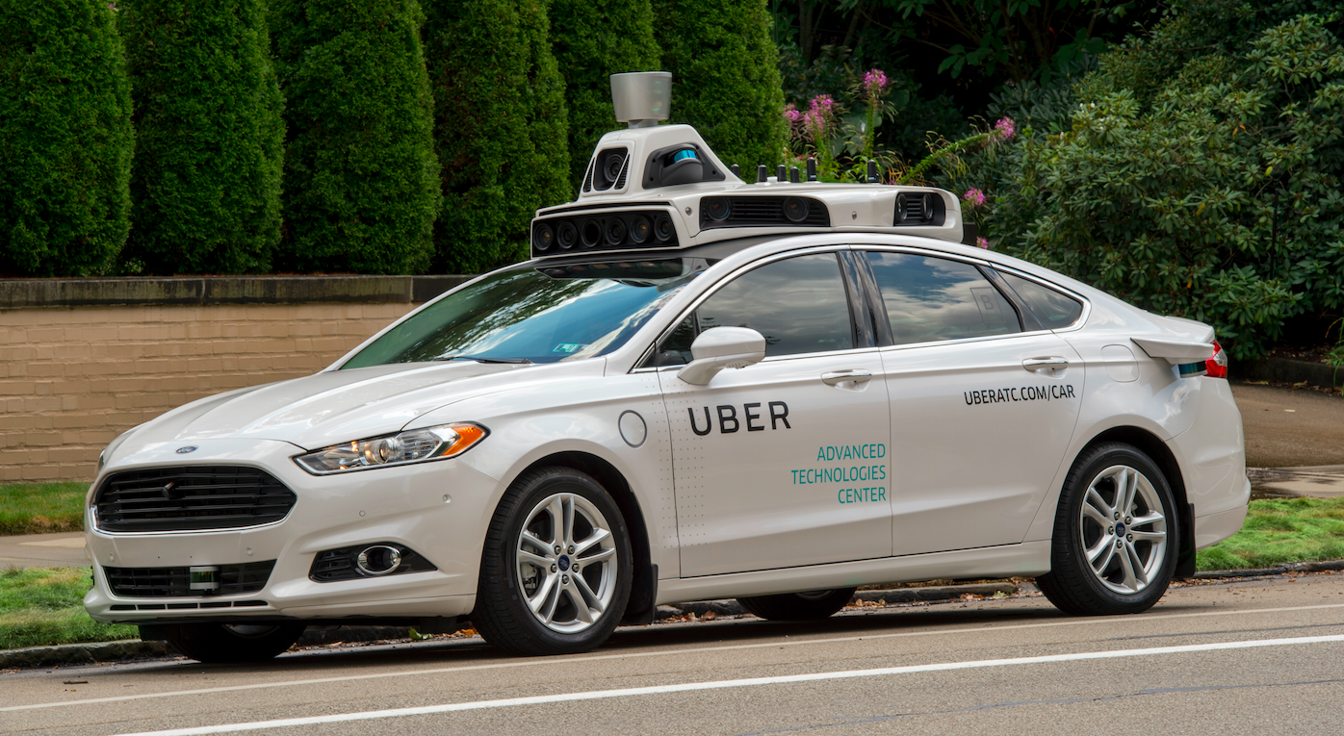
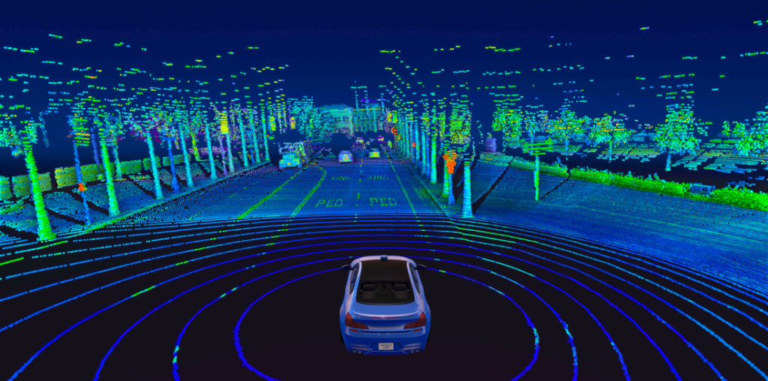
Project Innovations
Camera-only system (no LiDAR)
Real-time wireframe mesh using monocular depth
YOLOv8 + MiDaS integration
Decision-making to slow down / avoid potholes
Designed for unstructured Indian road conditions

Slide 6
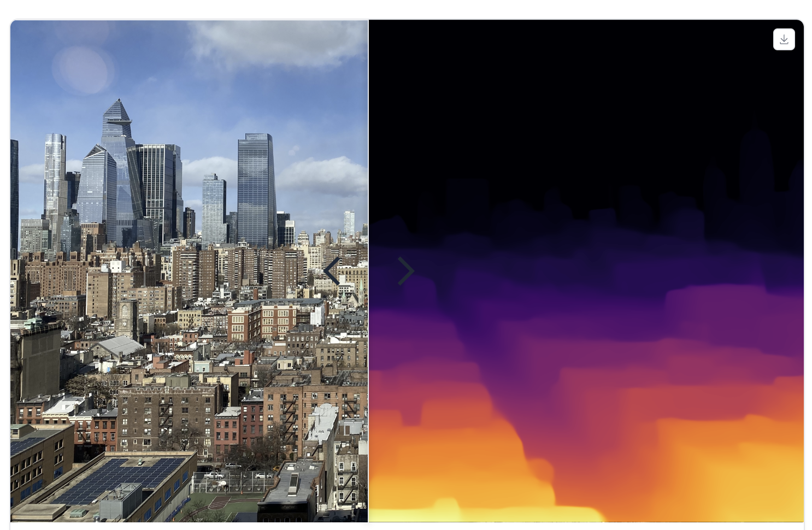
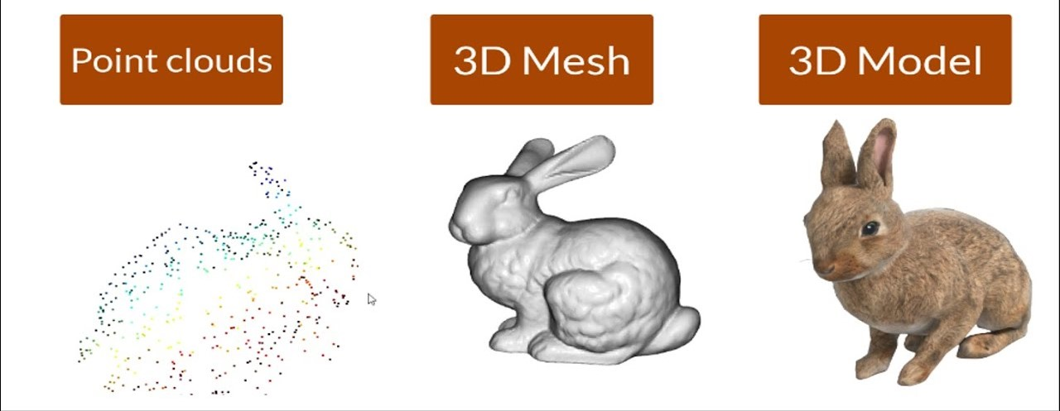
MiDaS
Open3D

Slide 7
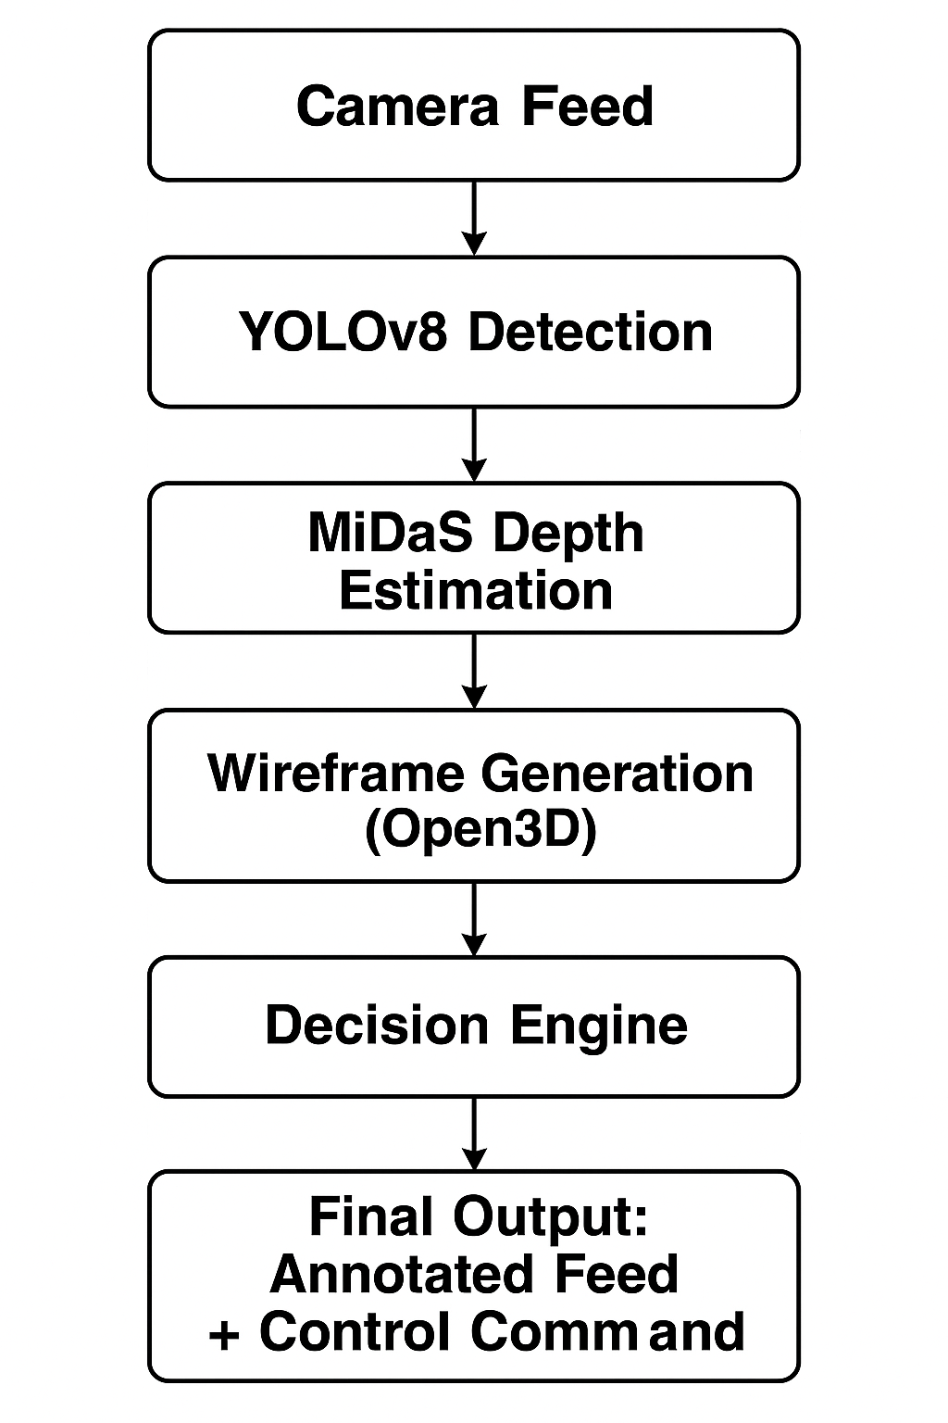
Project Workflow

Slide 8
Comparison: Existing Systems vs. My Project
Feature | Existing Systems | My Project
Sensor | LiDAR + Camera | Monocular Camera Only
Mesh Type | Point Cloud | Wireframe Mesh
Cost | High | Low
Usage | Offline Inspection + Existing static data | Real-time rendering & Vehicle Response

Slide 9
Current Status of the Project
Research paper review in progress
Technology identification and research in progress
Preparing prerequisites for Model Training

Slide 10
Conclusion
Estimated Low-cost of Prototype AVs, real-time pothole detection system
Combines vision, depth, mesh & AV logic
Assumed to be optimized for real-world road safety in India
Strong potential for AV deployment in India

Slide 11
Thank You

